Slide 1

Orientation Program on Retail

Slide 2
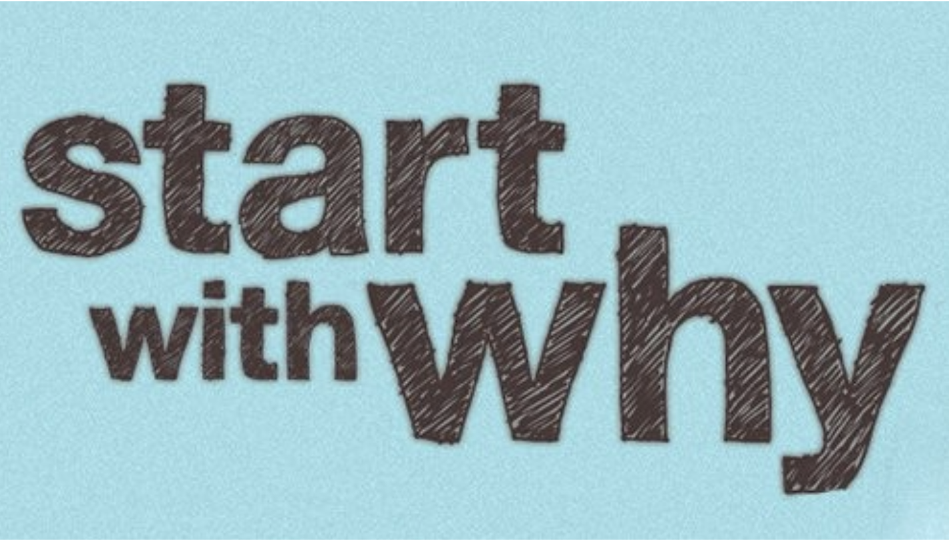


WHY
WHAT
WHY
WE DO
WE DO
@

Slide 3
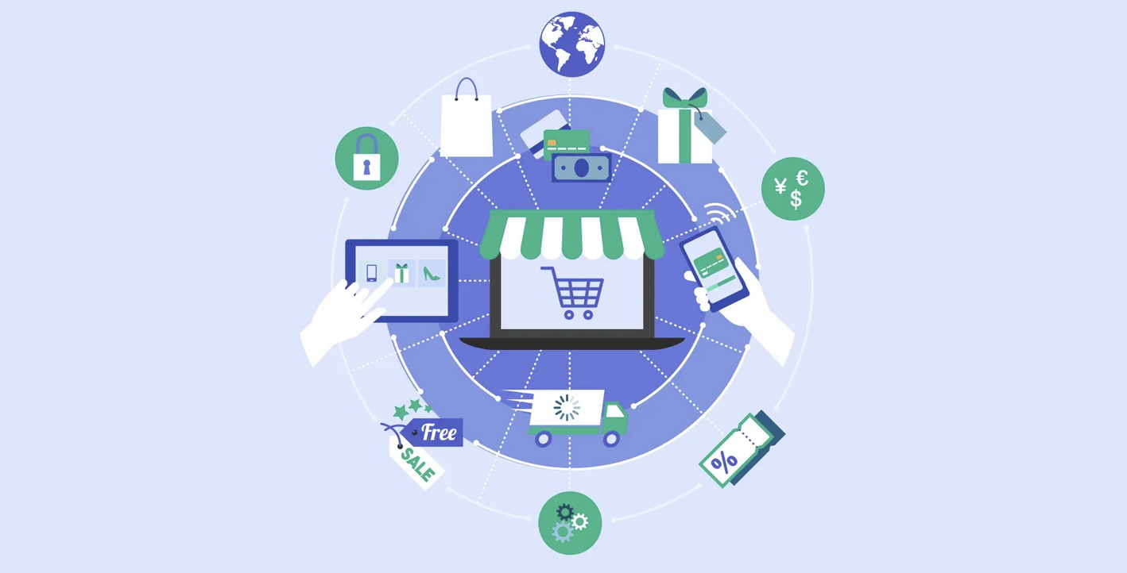
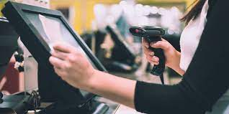
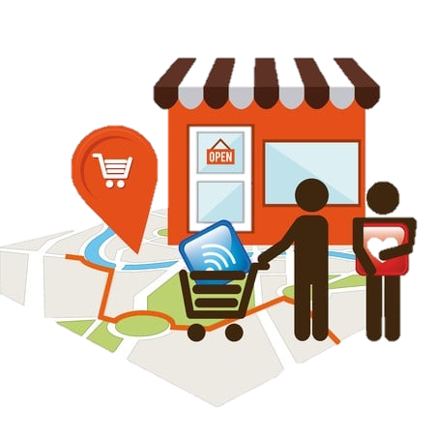

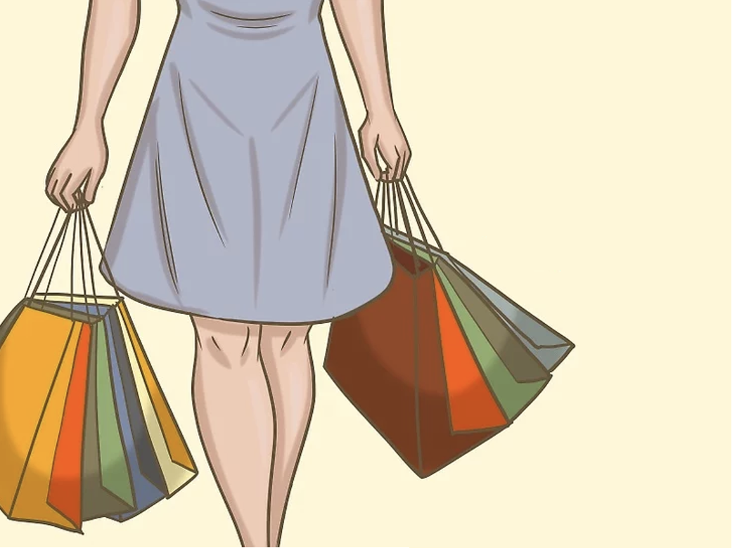
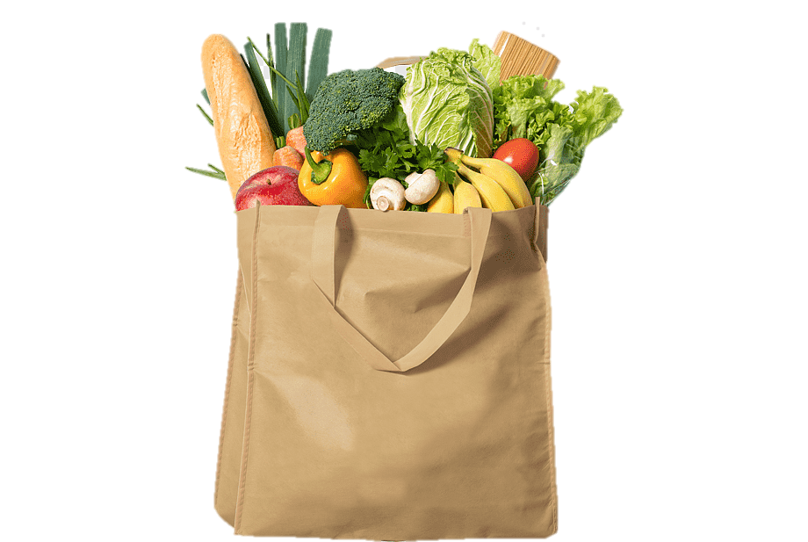




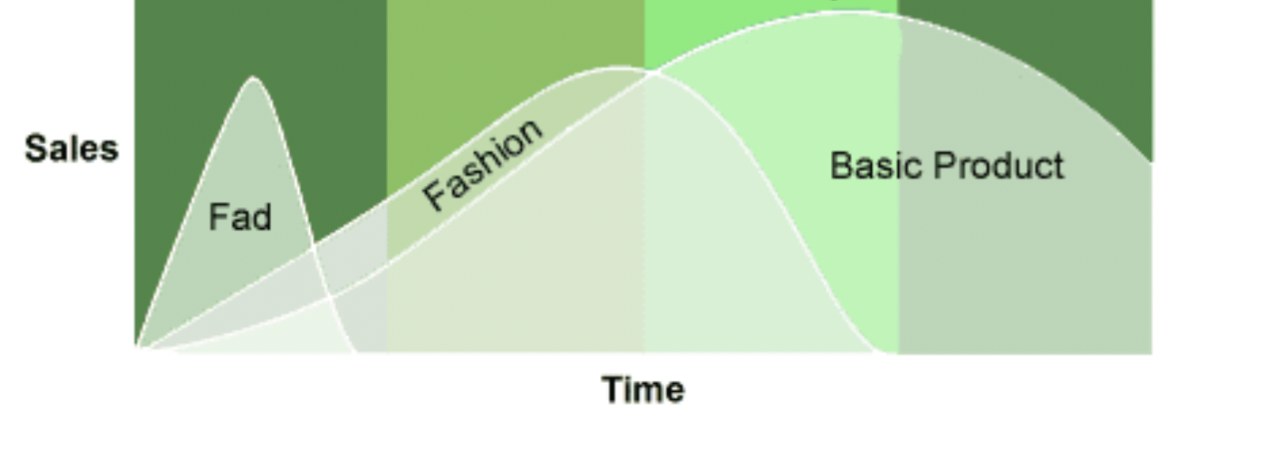
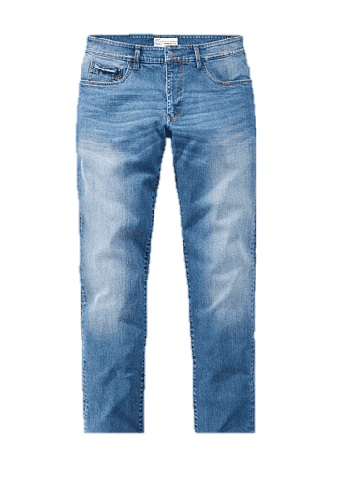
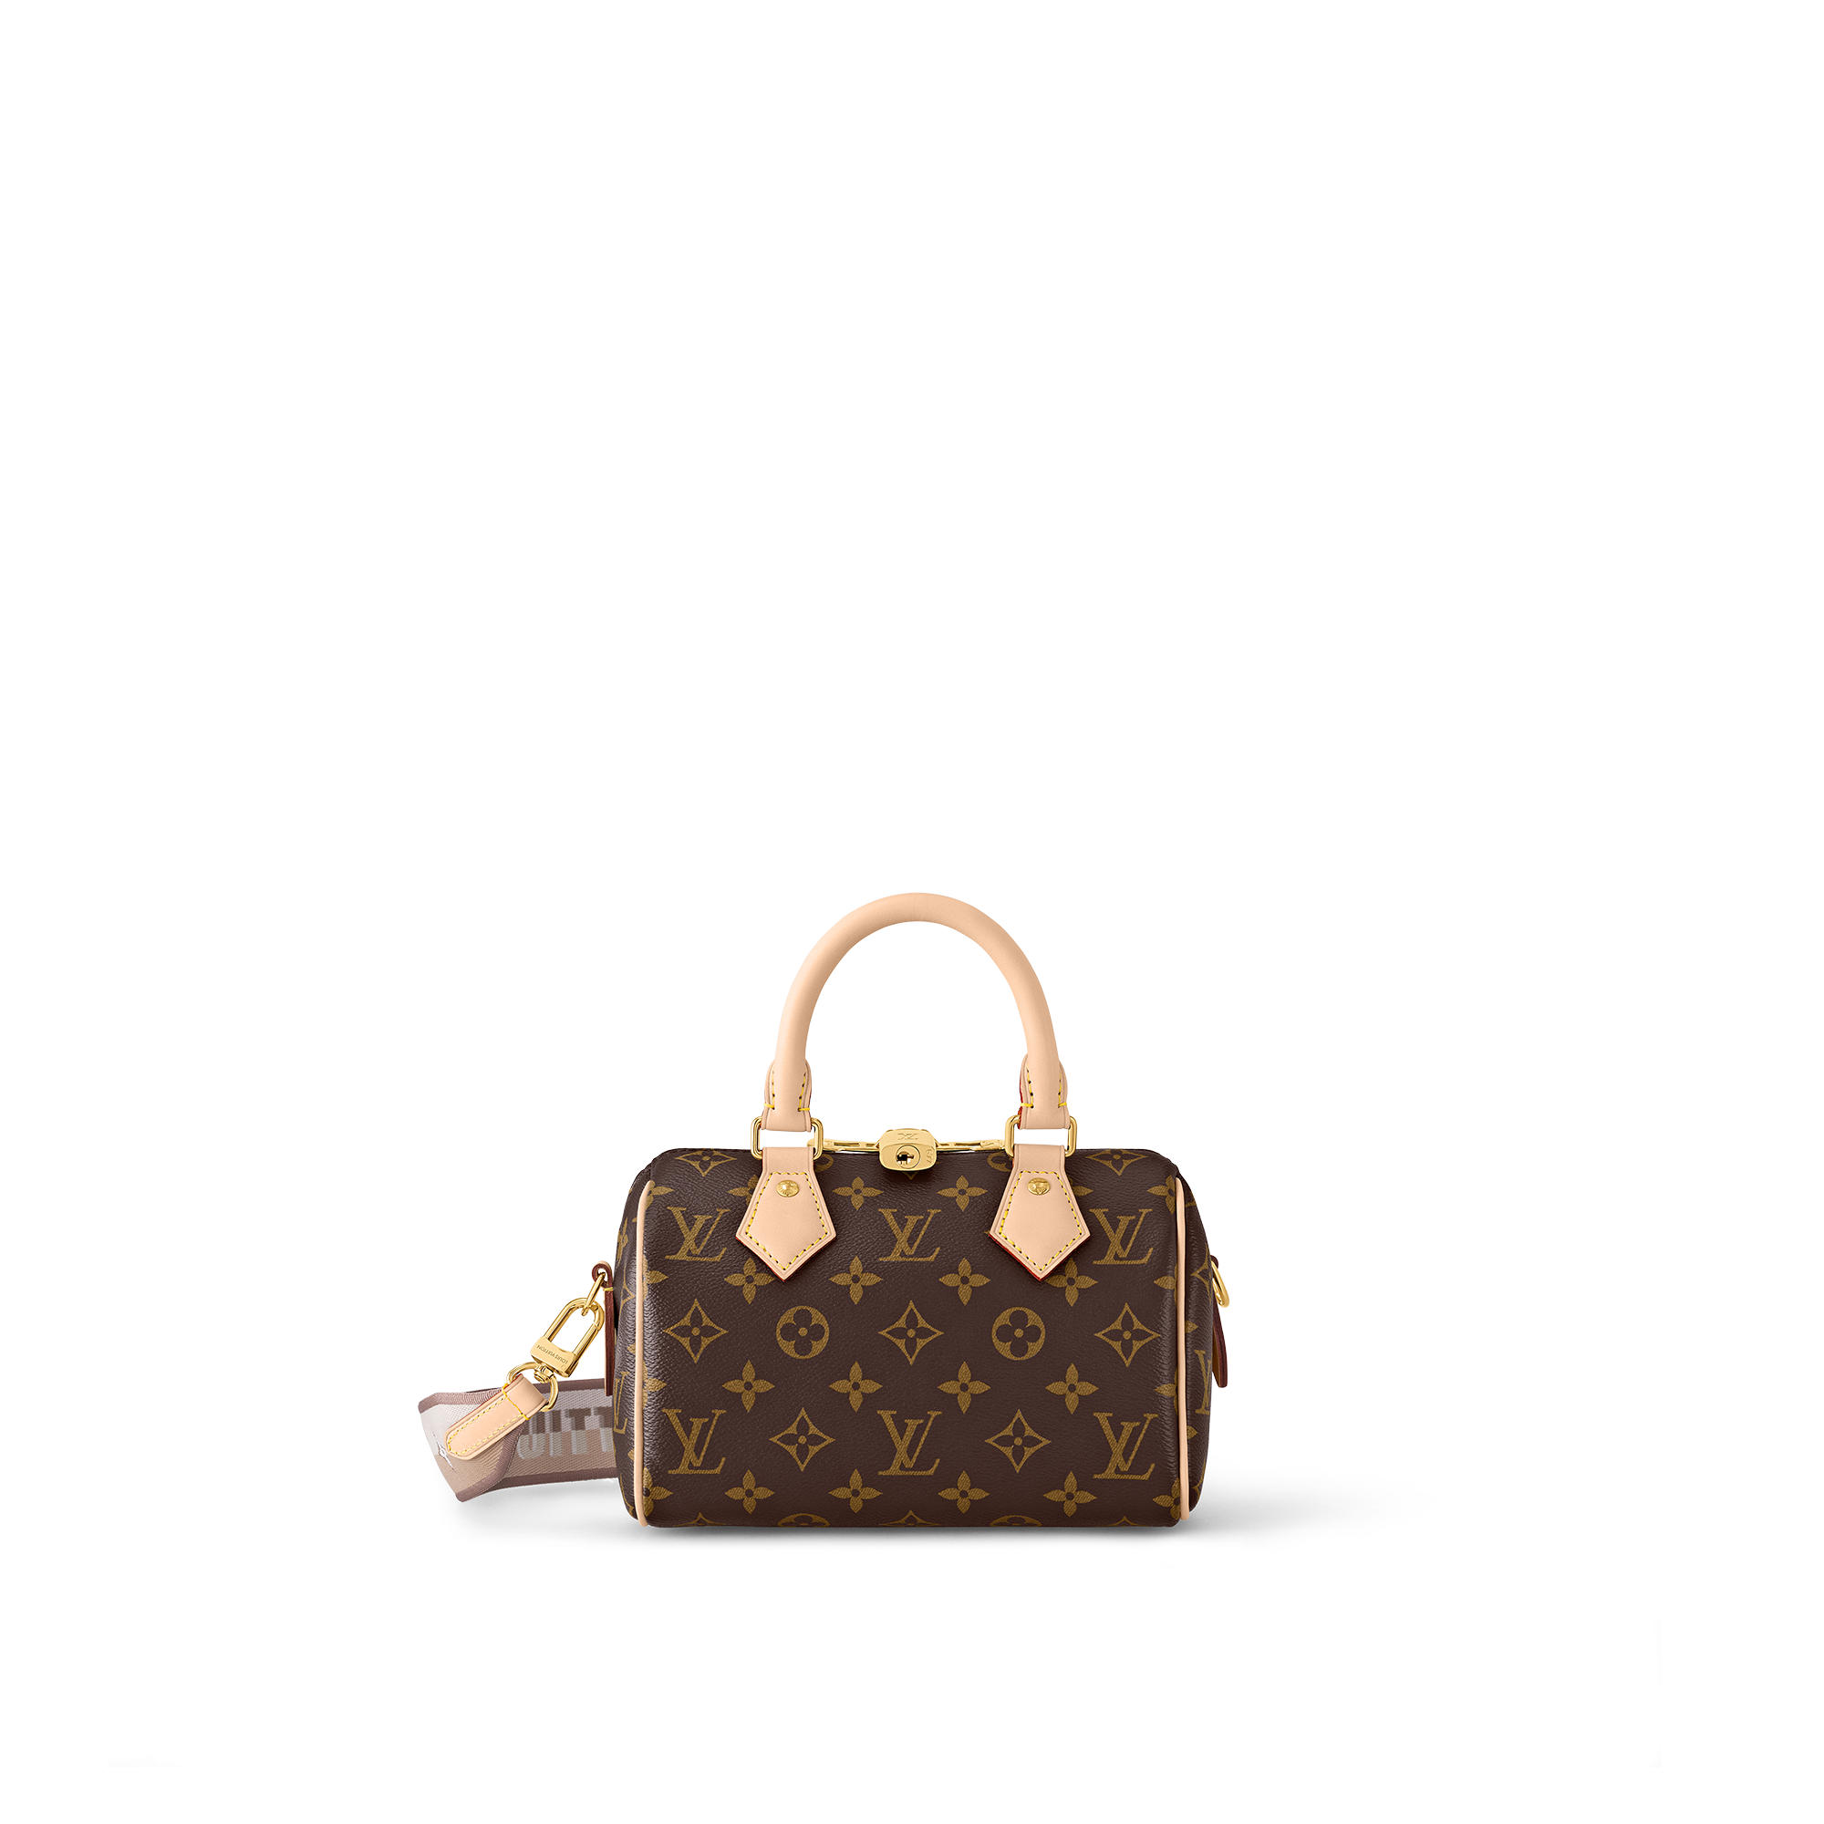



Aptos Beginning with some essentials
Retail Orientation
Retailer
Retail
Retailers
Sale of consumers goods to the end-customers in relatively small quantity for final consumption
Business orgs involved in retailing of consumer goods to make profit
The Retail Triangle
Customer
Goods/Products
Consumer goods
Lifecycle of consumer goods (apparel)
Convenience goods
Goods bought by customers for final consumption
Always sold to and used by end-consumers
Other terms – Consumer products, final goods, merchandise or just products
Types
Shopping goods
Specialty goods
Notes:
the global retail industry was valued at around USD 25.04 trillion in 2020
$6.02 trillion in 2020
United States: $22.68 trillion (5-6%)
China: $16.64 trillion (20-25%)
Japan: $5.08 trillion
Germany: $4.00 trillion
India: $3.05 trillion (10%)
United Kingdom: $2.78 trillion
France: $2.72 trillion
Italy: $2.06 trillion
Brazil: $1.47 trillion
Canada: $1.46 trillion
It's important to note that the retail industry's GDP contribution extends beyond the direct sales of goods and services. It also includes related activities such as employment generation, investment in retail infrastructure, and the multiplier effect on other sectors of the economy, such as manufacturing and services.
What is Fad?
Fad Color: Pastel Color, Neon, Metallic, Transparent
Fad Pattern: Bohemian Style, Tie-dye, Camouflage
Fad Fabric: Mesh, Velvet, French Terry
Fad Item: Animal Patterned Shirt, Tie-dye Jeans, Tennis Skirt
What is Fashion?
Fashion Color: Ivory, Beige, Brown, Khaki, Navy
Fashion Pattern: Printed T-shirt, Animal Print, Floral Print
Fashion Fabric: Corduroy, Jersey, Chiffon
Fashion Item: Crop Top, Skinny Jeans, Squared Toe Sandals
What is Classic?
Classic Color: Black, Gray, White (Achromatic Colors)
Classic Pattern: Plain, Polka Dot, Stripe, Check
Classic Fabric: Denim, Leather, Silk/Satin, Lace
Classic Item: Trench Coat, Blazer, White Shirt, Pencil Skirt

Slide 4
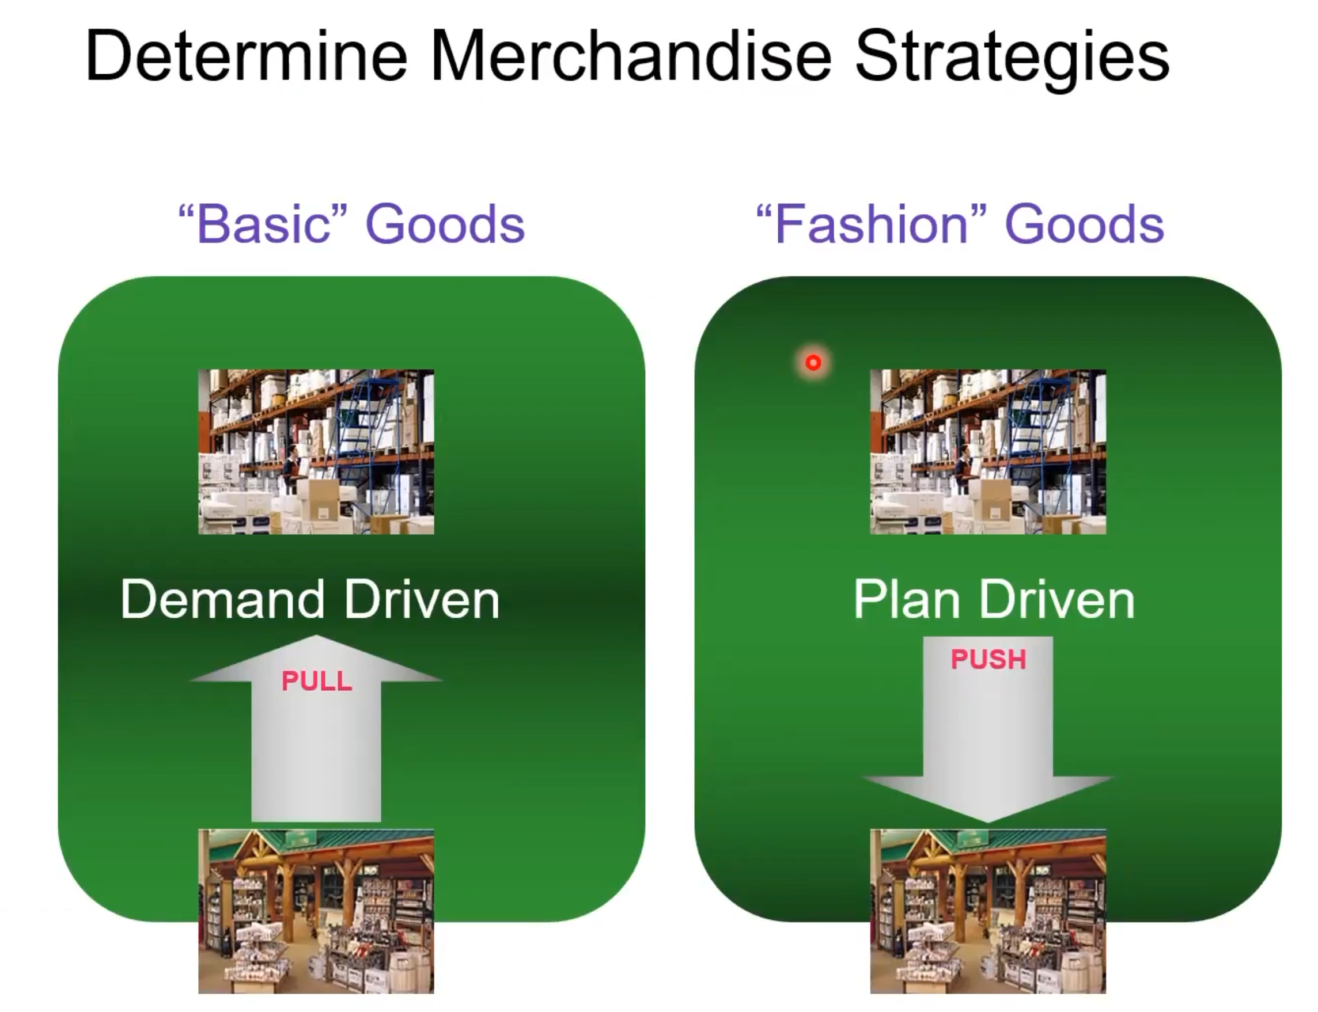
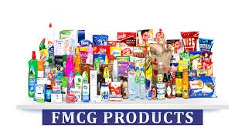
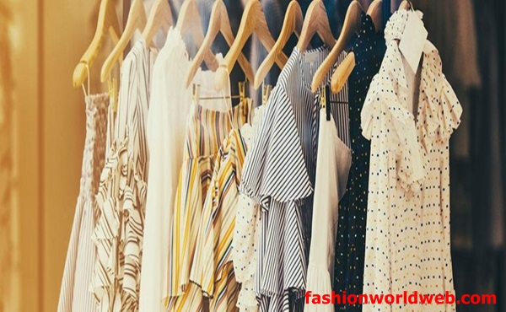
Aptos Merchandising strategy

Slide 5
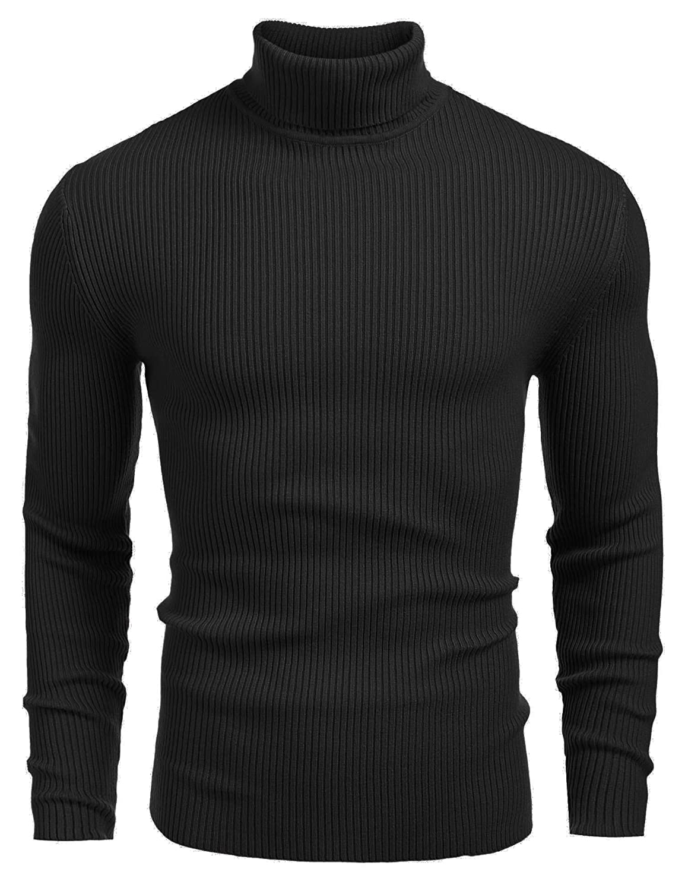
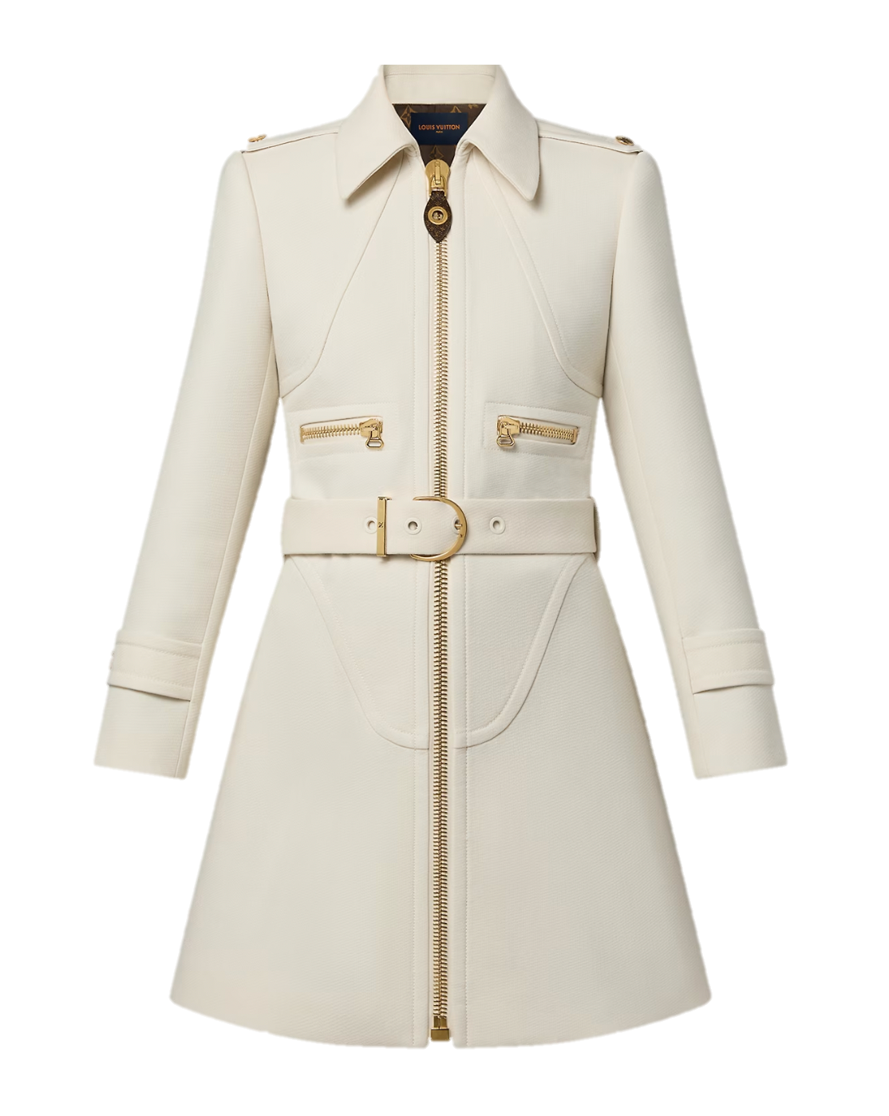
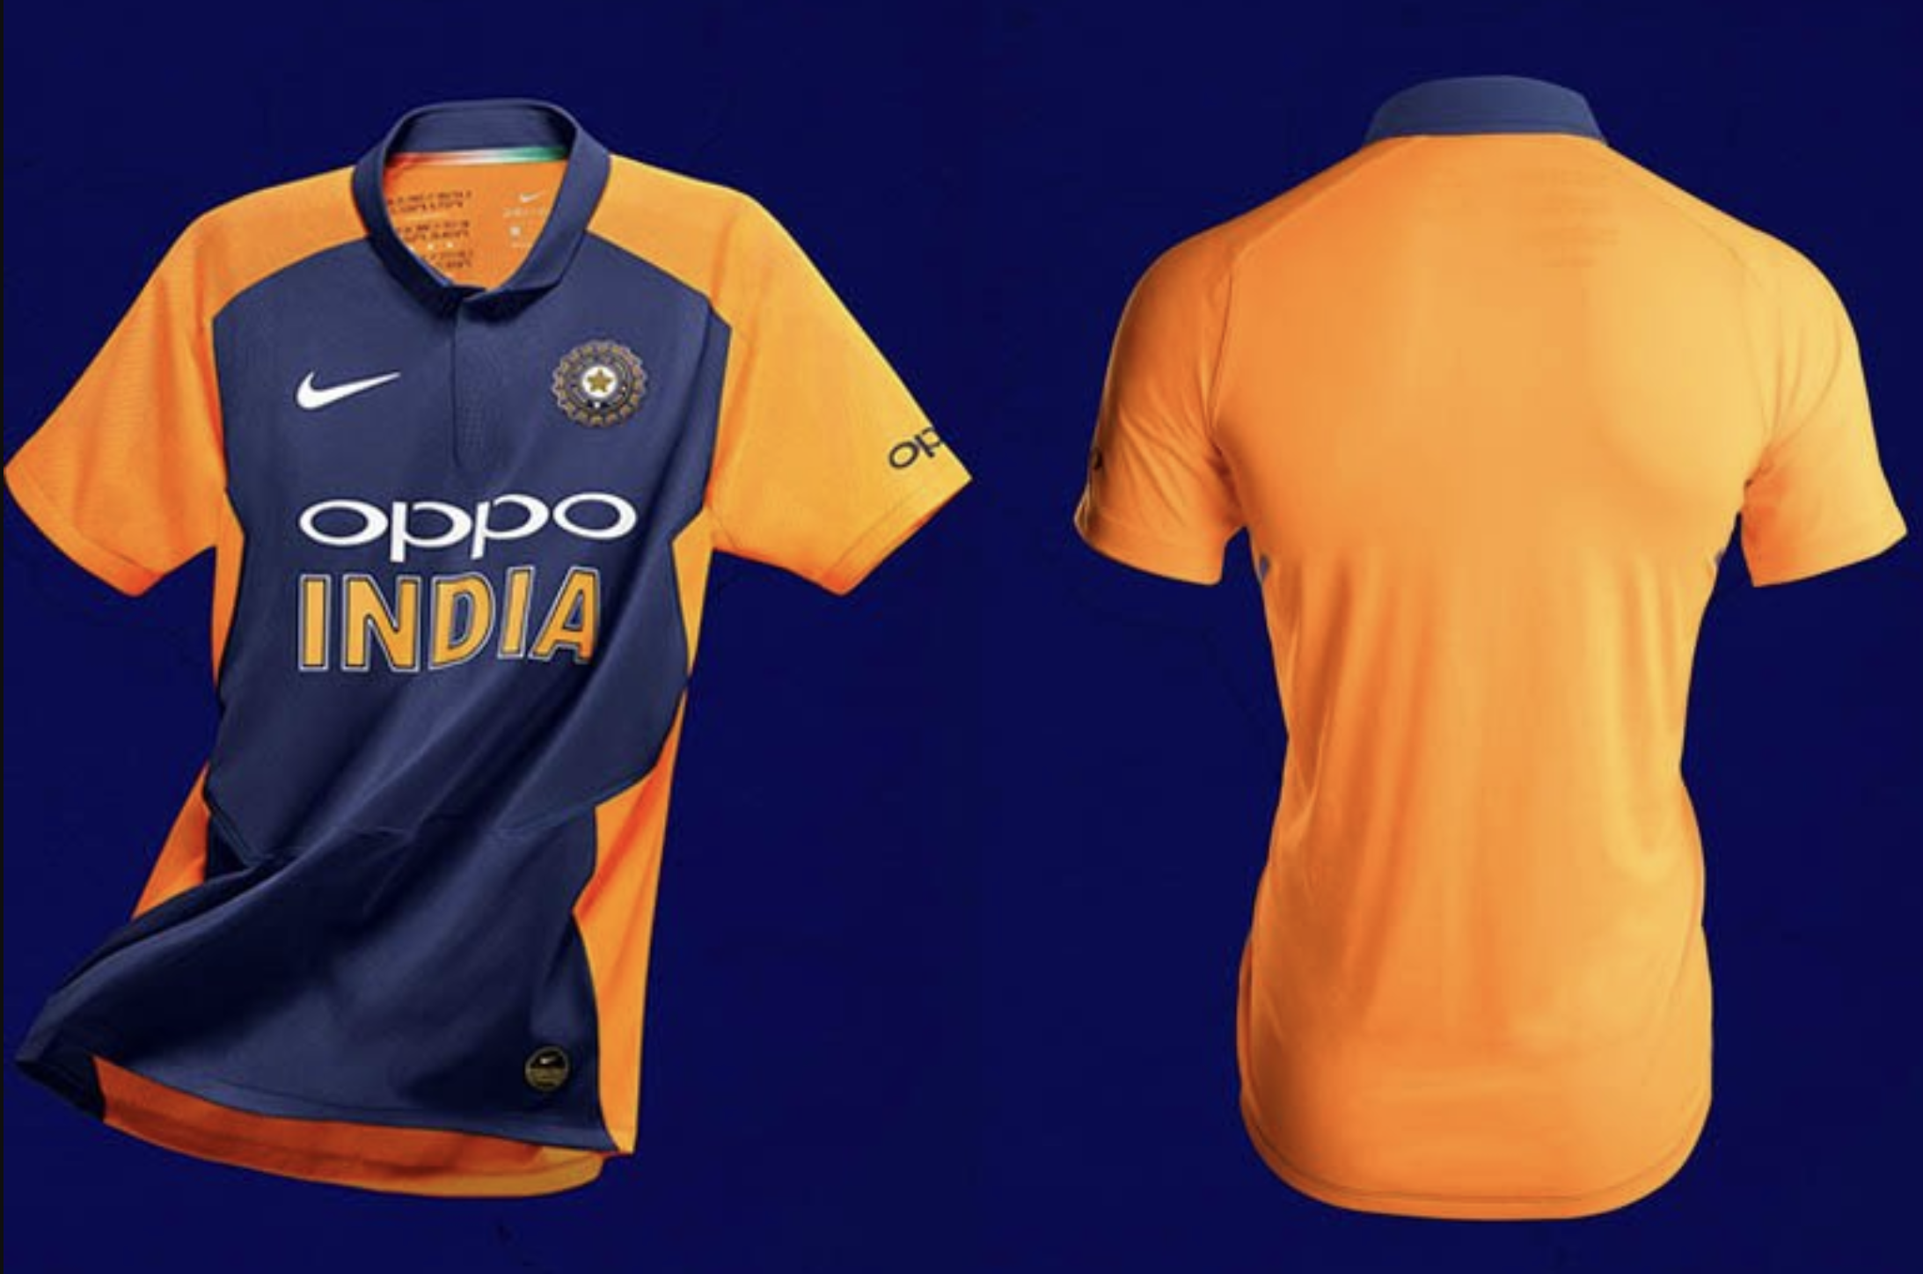

Slide 6
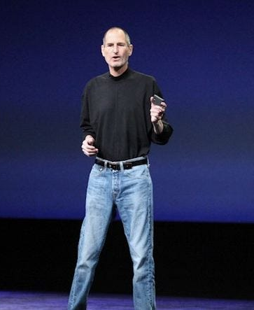

Slide 7
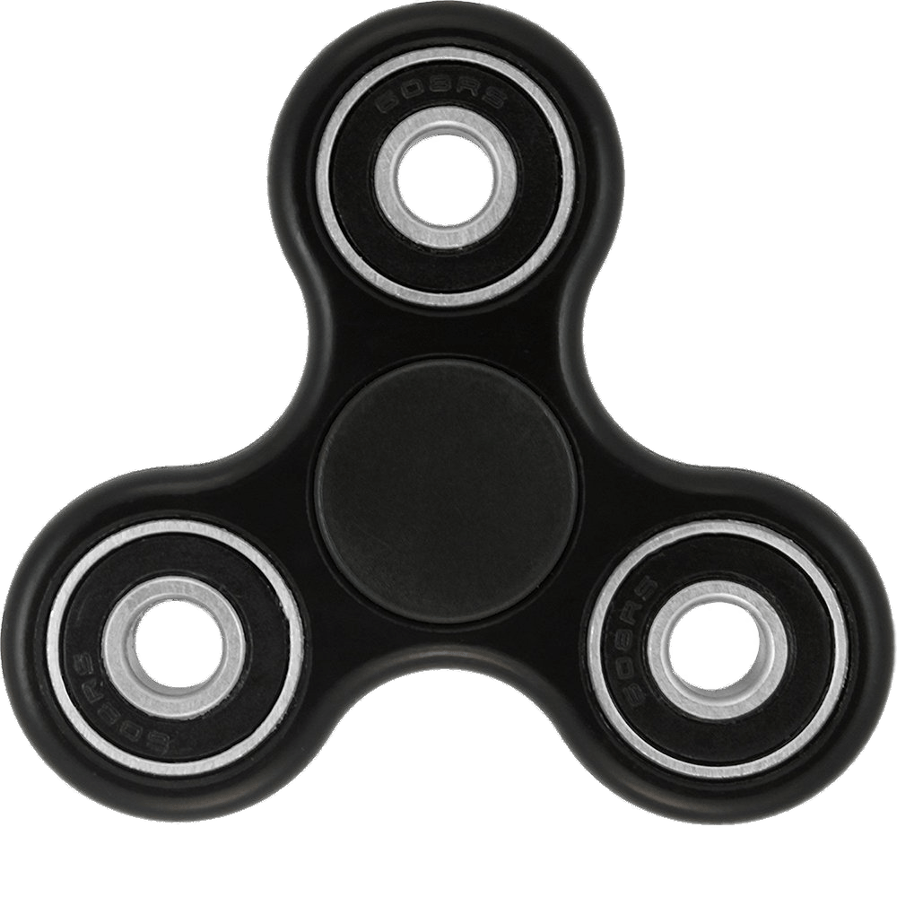

Slide 8
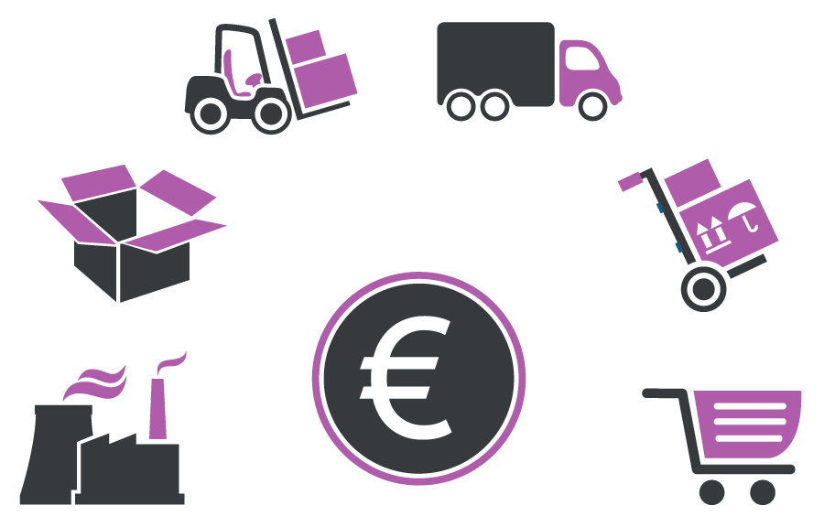

Retail Orientation
Retail and Supply Chain Perspective
Supplier
Manufacturer
Distributor
Retailer
Customer
Rubber Mfg
Tire Supplier
Supplier
Gear Supplier
Hardware Supplier
Online store
(Fulfilment Center)
Customer
Supplier
Pedal Supplier
Bicycle
Distributor
Retail Store (multi-brand)
Customer
Smelter
Casting Plant
Manufacturer
Frame Supplier
Retail Store (brand-owned)
Customer
Pigment Supplier
Tier-1 Suppliers
Paint Supplier
Chemical Mfg
Tier-3 Suppliers
Tier-2 Suppliers
Source: CTL.SC1x - Supply Chain and Logistics Fundamentals

Slide 9


Retail and Supply Chain Perspective
Supplier
Manufacturer
Distributor
Retailer
Customer
Software Vendor
Partners

Slide 10


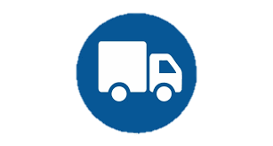


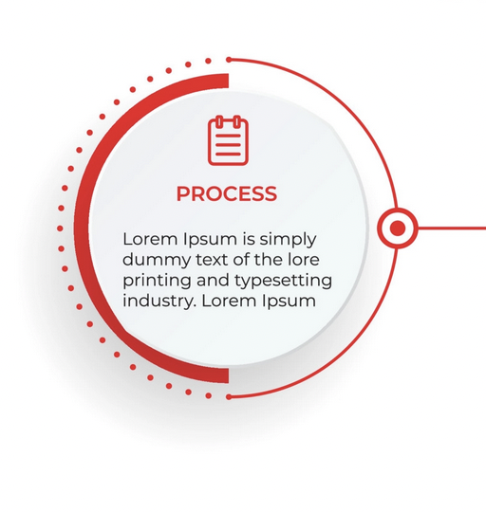
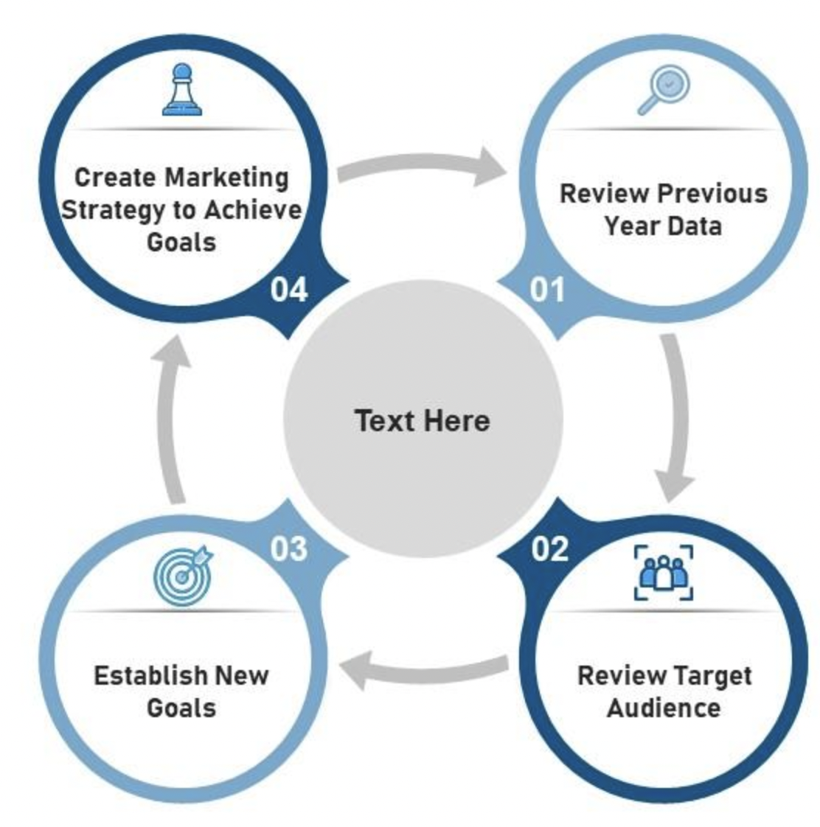

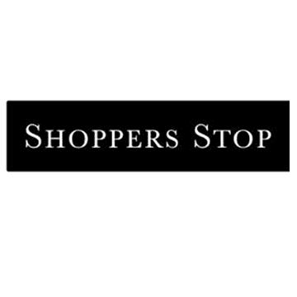
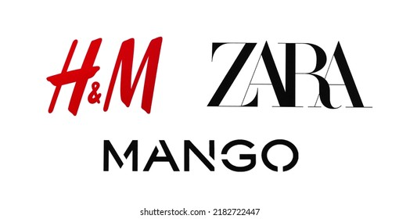

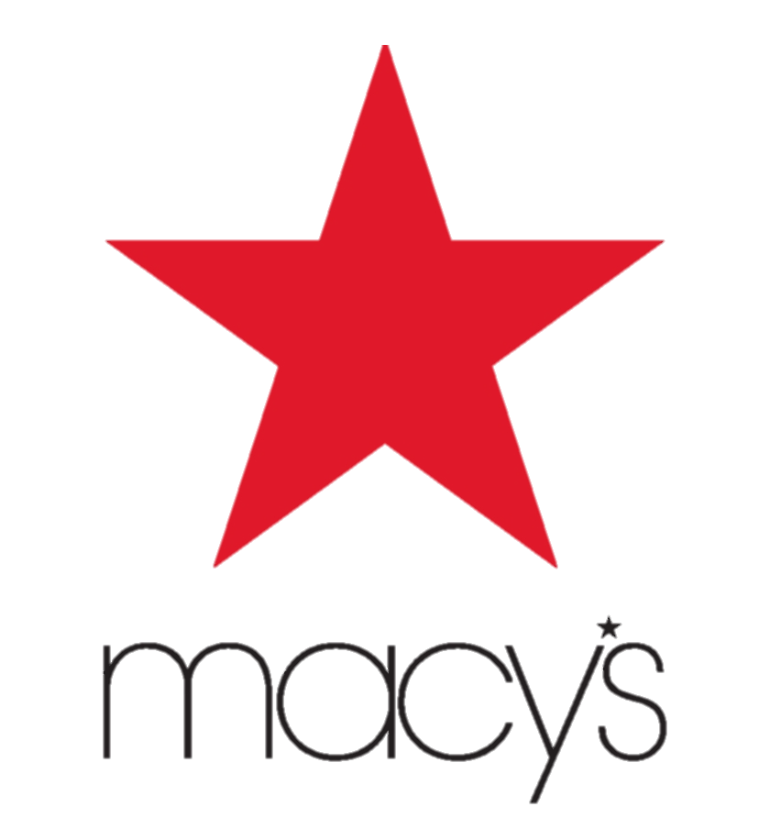



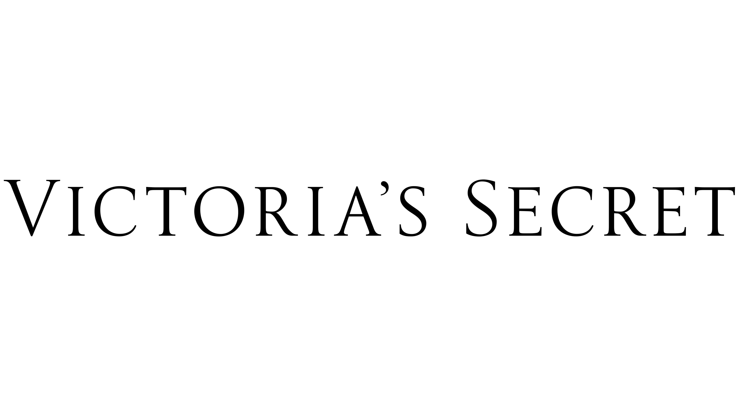

Retail Orientation
Key activities in retail business
PLAN
PROCURE
MOVE
SELL
Process of anticipating demand for products and planning supply. Stepping-stone for sourcing, distribution and sale to meet sales and margin targets
Process of acquiring merchandise to sell later. Sourcing can either be own production or buying ready-to-sell products
Process of getting merchandise into the business, and distributing through different channels to make their way to the final consumers
Final step of the retail value chain where merchandise is exchanged for money. Involves display,
promotion and management of inventory
DATA & ANALYTICS
Retail business operating model
VERTICALLY INTEGRATED BRANDS
MULTI-BRAND RETAIL
Own Production
Buy ready product
SELL
PLAN
Owns or controls manufacturing, design, distribution and retailing of products
Vertical integration should be seen in continuum
Sell multiple brands under one roof
Merchandise is sourced directly from the brands or the distributors
ANALYTICS
MOVE
PROCURE
Notes:
Aptos’ client (Vertically Integrated) – True Religion, Tumi, New Balance, Converse, Crocs

Slide 11
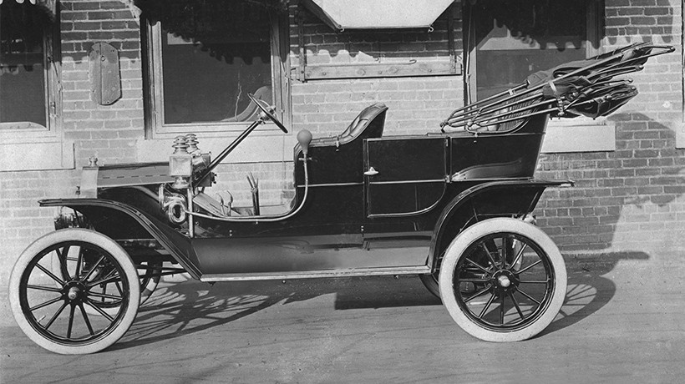

Slide 12
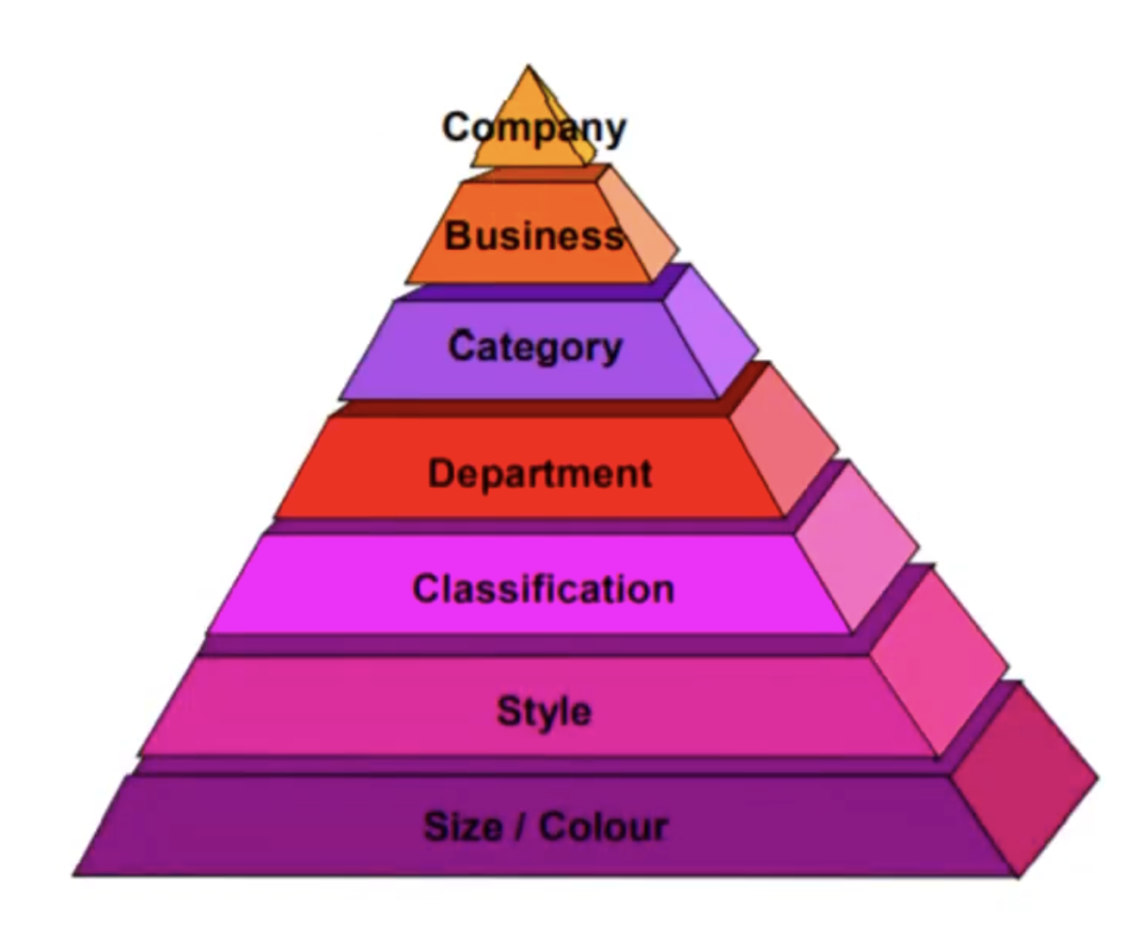
Merchandise Hierarchy
Fashion
Apparel
Men’s wear
Shirts
Formal Shirts
Men White Classic Fit Textured Full Sleeves Formal Shirt

Slide 13
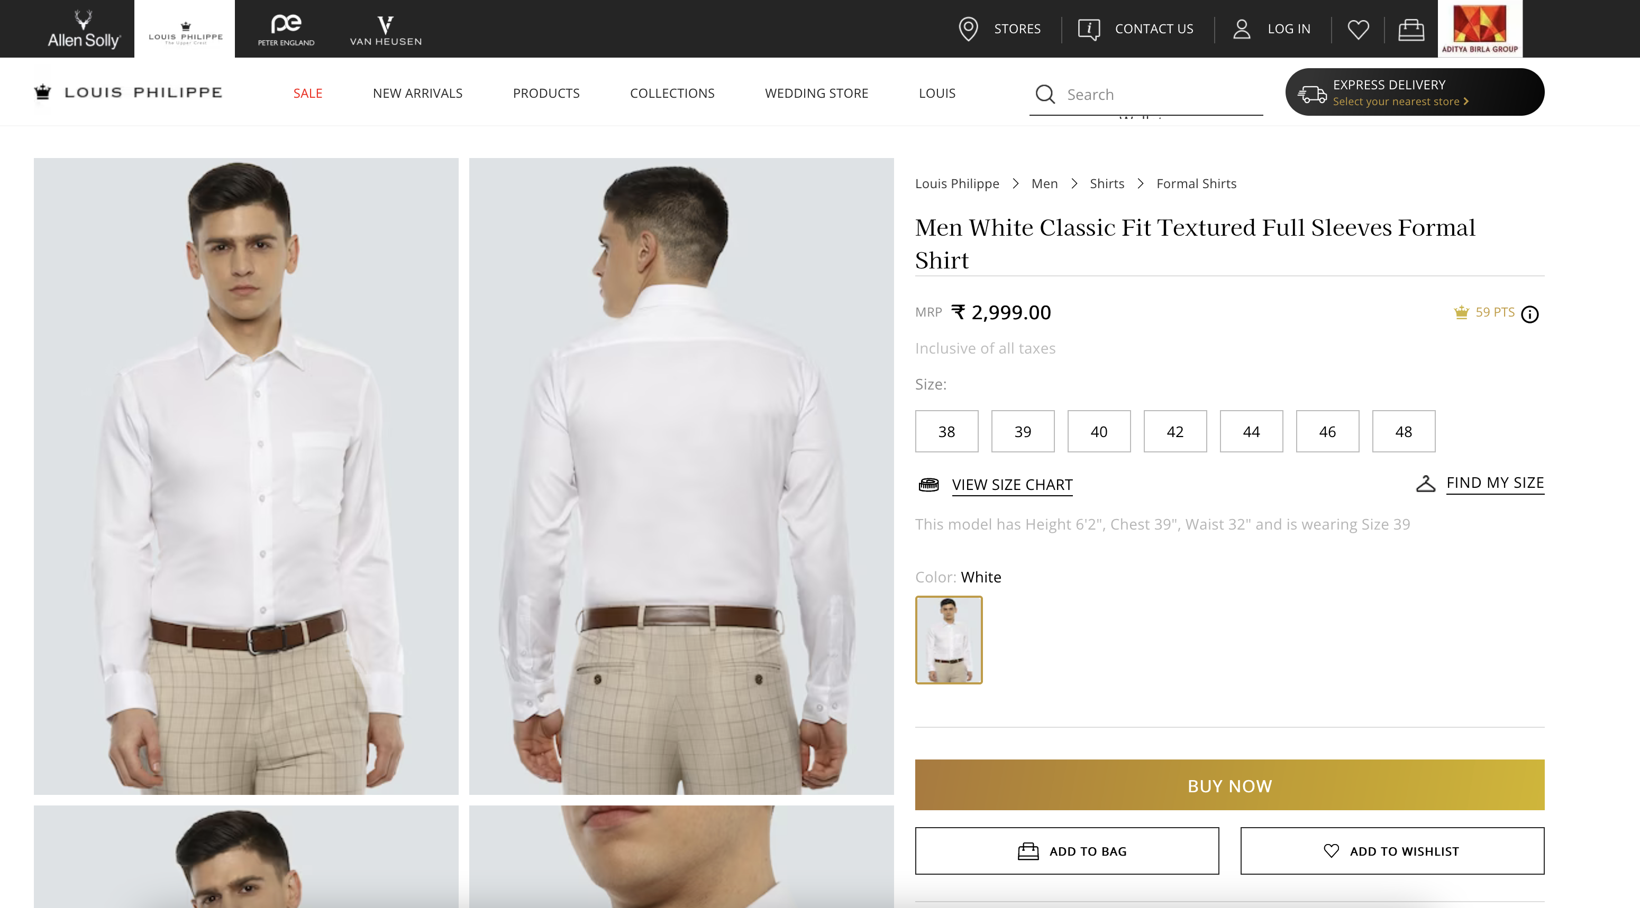

Slide 14
Retail Orientation
Business process perspective of retail
Plan
Demand Forecasting
Merchandise Financial Planning
Range Planning
Store Grading
Assortment Planning
Buy Plan/Open to Buy
Product Pricing
Size scaling and pack optimization
Allocation & Replenishment plan
Visual merchandising
Buy
Supplier identification, evaluation and selection
Create and transmit PO and supplier acknowledgment
Order tracking and Shipment notification
Receive goods and receipt note
Invoice processing & payment
Spend Management
Punchout
CPQ
Receive
Put-away
Pick
Pack & ship
Move
Schedule arrivals
Yard management
Material receipts
Unloading and staging
Inspection
Material handling
Slotting
Move material to storage location
Record storage location
Verify on-hand inventory
Move material from storage location for orders
Place in package(s)
Confirm documents
Place in package(s)
Schedule pick up
Load vehicle
Handle returns
Value-add services
Sell
Marketing
Commerce
Markdown/Promotion
Personalization
Campaign Management
Store operations
Digital Channels
Real-time Inventory
Fulfillment
Service
Order Promise
Order Orchestration
Shipping
Customer Service Center
Returns Management
Order Tracking
Foundational
Customer Data
Product Information
Employee data
Sales Audit
Content and digital assets
Stock Ledger
Analytics & Insights

Slide 15
Retail Intro
Order-To-Cash (O2C) and Procure-To-Pay (P2P) processes
O2C process cycle
1
2
3
4
5
Receive order from the customer
Accept and fulfill the order
Ship the order
Send invoice to the customer
Record the payment
P2P process cycle
1
2
3
4
5
Identify requirement
(item, quantity etc.)
Create and approve purchase orders
Receive goods
Receive invoice and match the invoice
Pay the vendor
Process type | Purpose of the process | Organization roles
Order-To-Cash (O2C) | Processing orders from clients and realize revenue | The sales, accounts receivable, and product shipping or inventory management teams
Procure-To-Pay (P2P) | Sourcing and paying for the products and services from the suppliers | The procurement and purchase team, accounts payable department
Notes:
O2c
The customer places an order
The O2C cycle starts the moment a customer places an order for any products or services.
The business fulfills the order
After the order is placed, the business either prepares the goods for shipment or organizes a service appointment with the customer.
The business ships the order
The goods are then shipped to the customers or the service is provided on the specified date and time.
The business sends the invoice(s) to the customer
Once the product is received by the customer or the service delivered, the business generates and sends the invoice to the customer for payment.
Receive and record the payment
Lastly, the accounts receivable team of the company will record the customer’s payment in the ledger.
P2P
Identify your requirements
The first step before your business places an order with a supplier is to identify your requirements—item type, quantity, quality, etc. This step helps prepare the purchase orders, evaluate potential vendors, and estimate the cost of the goods or services required.
Create a purchase requirement
After identifying your needs, the purchasing department must create a purchase requisition, which is an internal purchase request document that the accounting team must validate. If the accounting department accepts the purchase requisition, the procurement and purchase team sends the vendor a document known as the purchase order (PO). Purchase orders are the formal, outward-facing purchase requests.
Receive approval for the purchase orders
Purchase order approval can be time-consuming since they require multiple iterations from both the supplier and the customer to ensure the authenticity and accuracy of the specifications. It often requires numerous rounds of internal and external adjustments before both the parties involved in the deal accept the PO.
Receive the invoice from the vendor
Once the purchased products or services are collected by the customer, the vendor will issue an invoice to the client, who will then initiate the payment process through their accounts payable(AP) staff.
Make the payment
The customer’s finance team must ensure that the invoice is received and entered into the company’s accounting system. Some businesses perform this task manually, making the process tedious, time-consuming, and prone to errors.

Slide 16
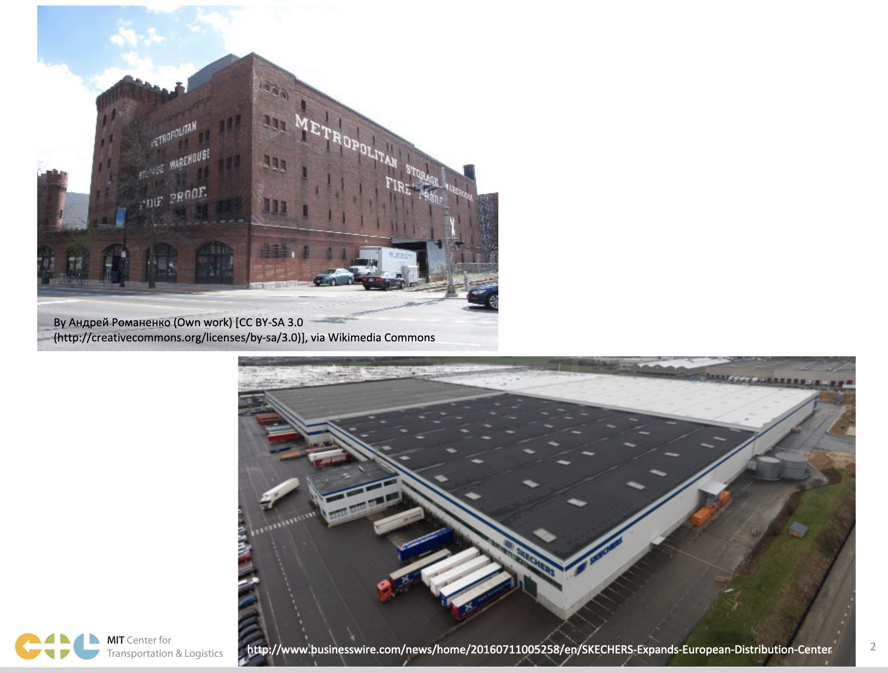
Warehouse and Distribution Center

Slide 17
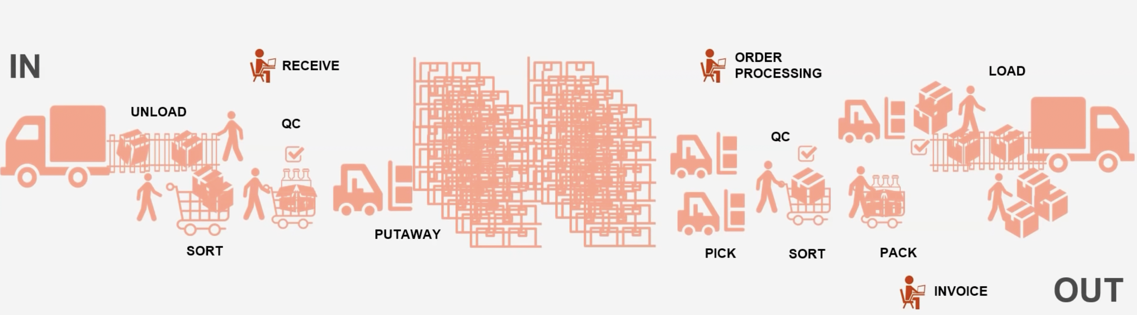
Schematic diagram of material flow in warehouse

Slide 18
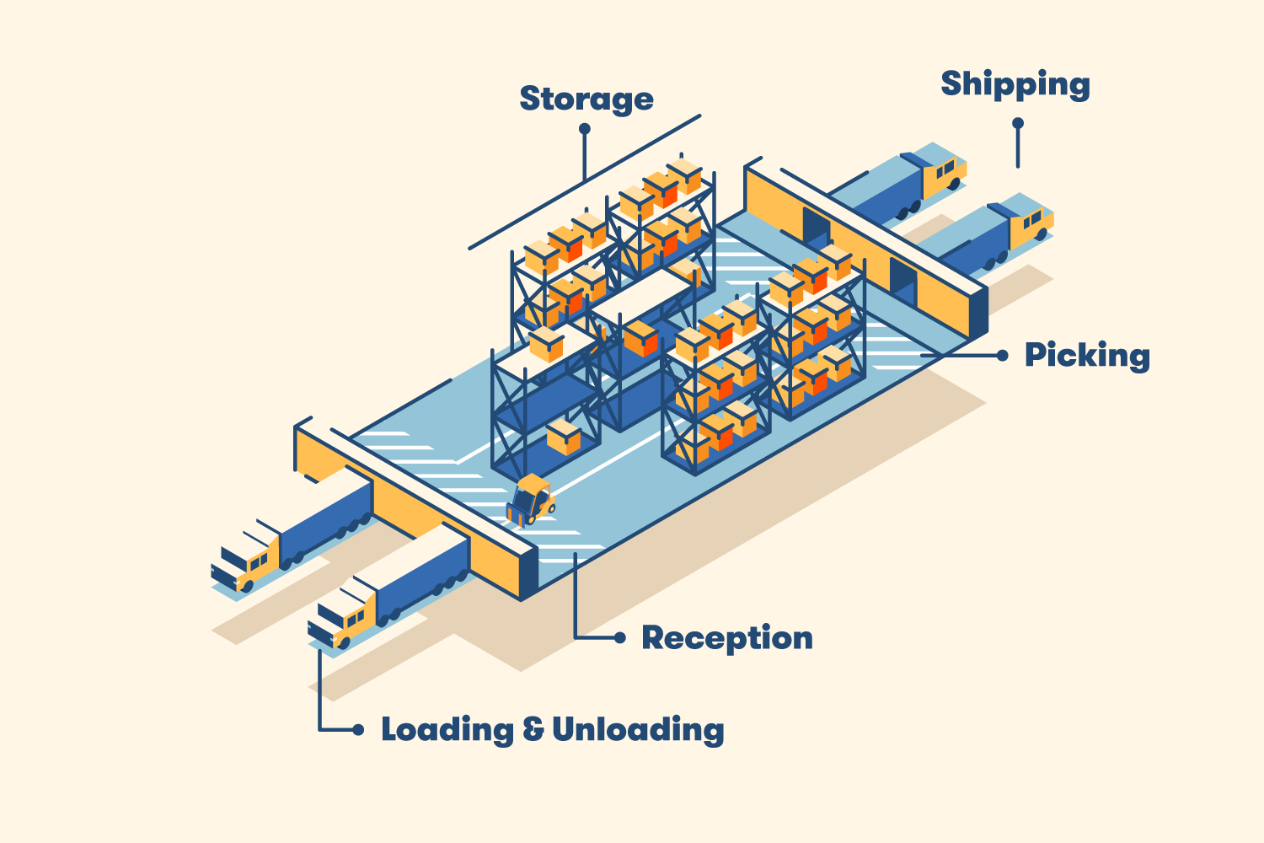
Warehouse layout – I shaped design
Source: www.bigrentz.com/blog/warehouse-layout

Slide 19
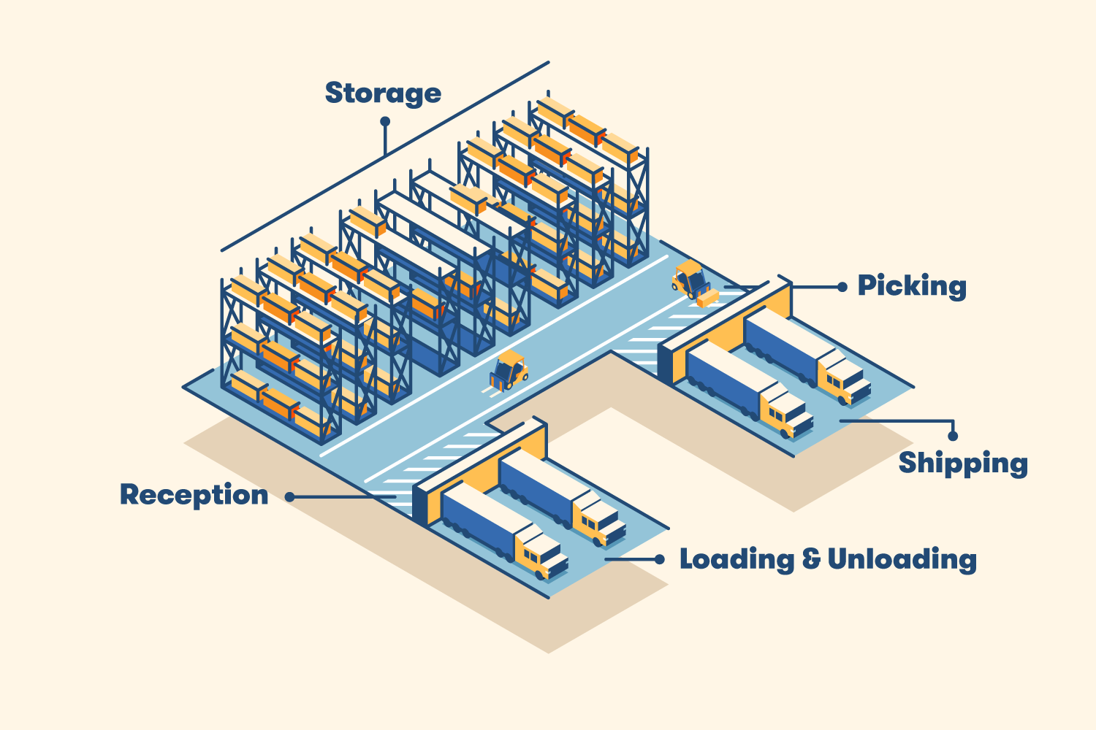
Warehouse layout – U shaped design
Source: www.bigrentz.com/blog/warehouse-layout

Slide 20
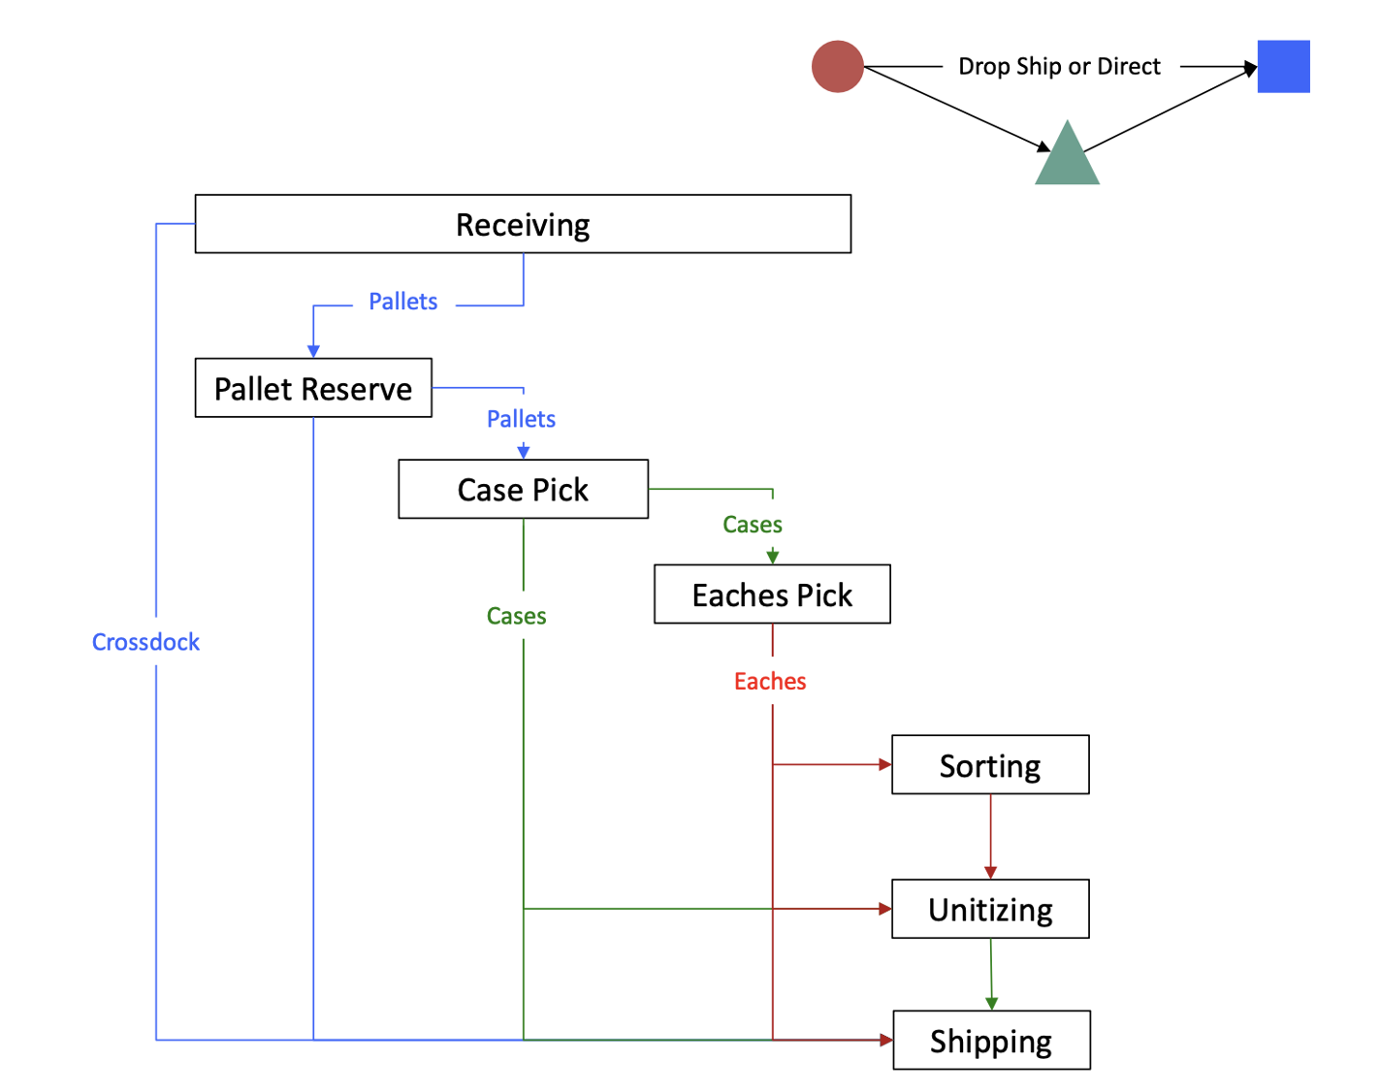
Handling units and common material flow patterns in Warehouse
Supplier
Store
DC
Source: CTL.SC1x - Supply Chain and Logistics Fundamentals

